Slide 1
CHAPTER-6 Rolling Contact bearing
Tribhuwan University
Institute of Engineering
Pulchowk Campus

Slide 2


Load/life relationship
The relationship between load, F, and life L, for rolling contact bearings is given by
$\frac{L_{2}}{L_{1}}={\left(\frac{F_{1}}{F_{2}}\right)}^{a}$
Where,
a = 3 for ball bearings
a = 10/3 for roller bearing
Let us assume
F₁ = F_{R} =C₁₀= Rated load
F₂ = F_{D} = Design load
L₁ = L_{R} = L₁₀= Rated life (in rev)
L₂ = L_{D} = Design life (in rev)
$$C_{10}{\left(L_{R}×n_{R}×60\right)}^{\frac{1}{a}}=F_{D}{\left(L_{D}×n_{D}×60\right)}^{\frac{1}{a}}$$

Slide 3
SOME IMPORTANT TERMS USED IN BEARING PROBLEMS
C₁₀ (Catalog rating or basic load rating or basic dynamic load rating)
defined as the radial load that causes 10% of a group of bearings to fail at the rated life.
Rated Life (L₁₀)
defined as the number of revolutions that 90% of the bearings will complete or exceed before the first evidence of fatigue crack.
Equivalent Bearing Load (or Combined radial load)
The constant radial load in radial bearings, which if applied to the bearing would give same life as that the bearing will attain under actual condition of forces.

Slide 4
Load/Life Relationship problem 1
A Catalog lists the basic dynamic load rating (or catalog load rating or basic load rating) for a ball bearing to be 31370 N for a rated life of 1 million revolution. What would be the expected life of the bearing if it were subjected to a load of 15574 N ?

Slide 5
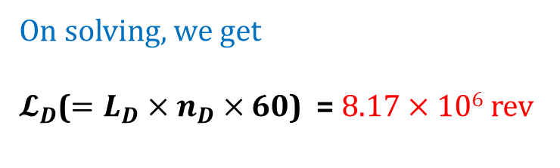
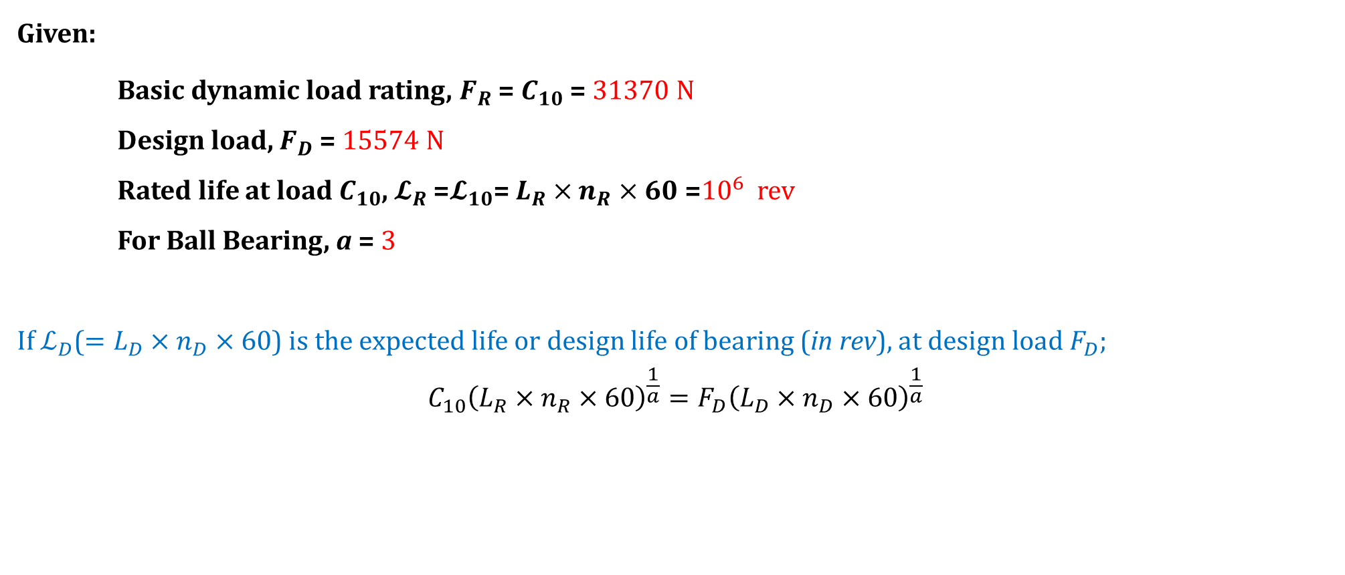
Load/Life Relationship problem 1 Solution
Given:
Basic dynamic load rating, $F_{R}$ = $C_{10}$ = 31370 N
Design load, $F_{D}$ = 15574 N
Rated life at load $C_{10}$, $𝓛_{R}$ =$𝓛_{10}$= $L_{R}×n_{R}×60$ =${10}^{6}$ rev
For Ball Bearing, a = 3
If $ℒ_{D}$($=L_{D}×n_{D}×60$) is the expected life or design life of bearing (in rev), at design load${ F}_{D}$;
$$C_{10}{\left(L_{R}×n_{R}×60\right)}^{\frac{1}{a}}=F_{D}{\left(L_{D}×n_{D}×60\right)}^{\frac{1}{a}}$$
Note: Use reliability of 90% unless otherwise stated.
Design Data handbook
Equation 2.1(a), Page 12
On solving, we get
$𝓛_{D}$($=L_{D}×n_{D}×60$) = 8.17 $×$ 10⁶ rev

Slide 6
Load/Life Relationship problem 2
For the bearing application specifications given, determine the basic load rating for a ball bearing with which to enter a bearing catalogue.
Radial Load = 3 kN
Design Life = 5 years, 40 h/week, 400 rev/min
Desired Reliability = 95%
Select a suitable single-row deep groove ball bearing. If angular contact bearing is to be used instead of ball bearing which bearing would you recommend?

Slide 7
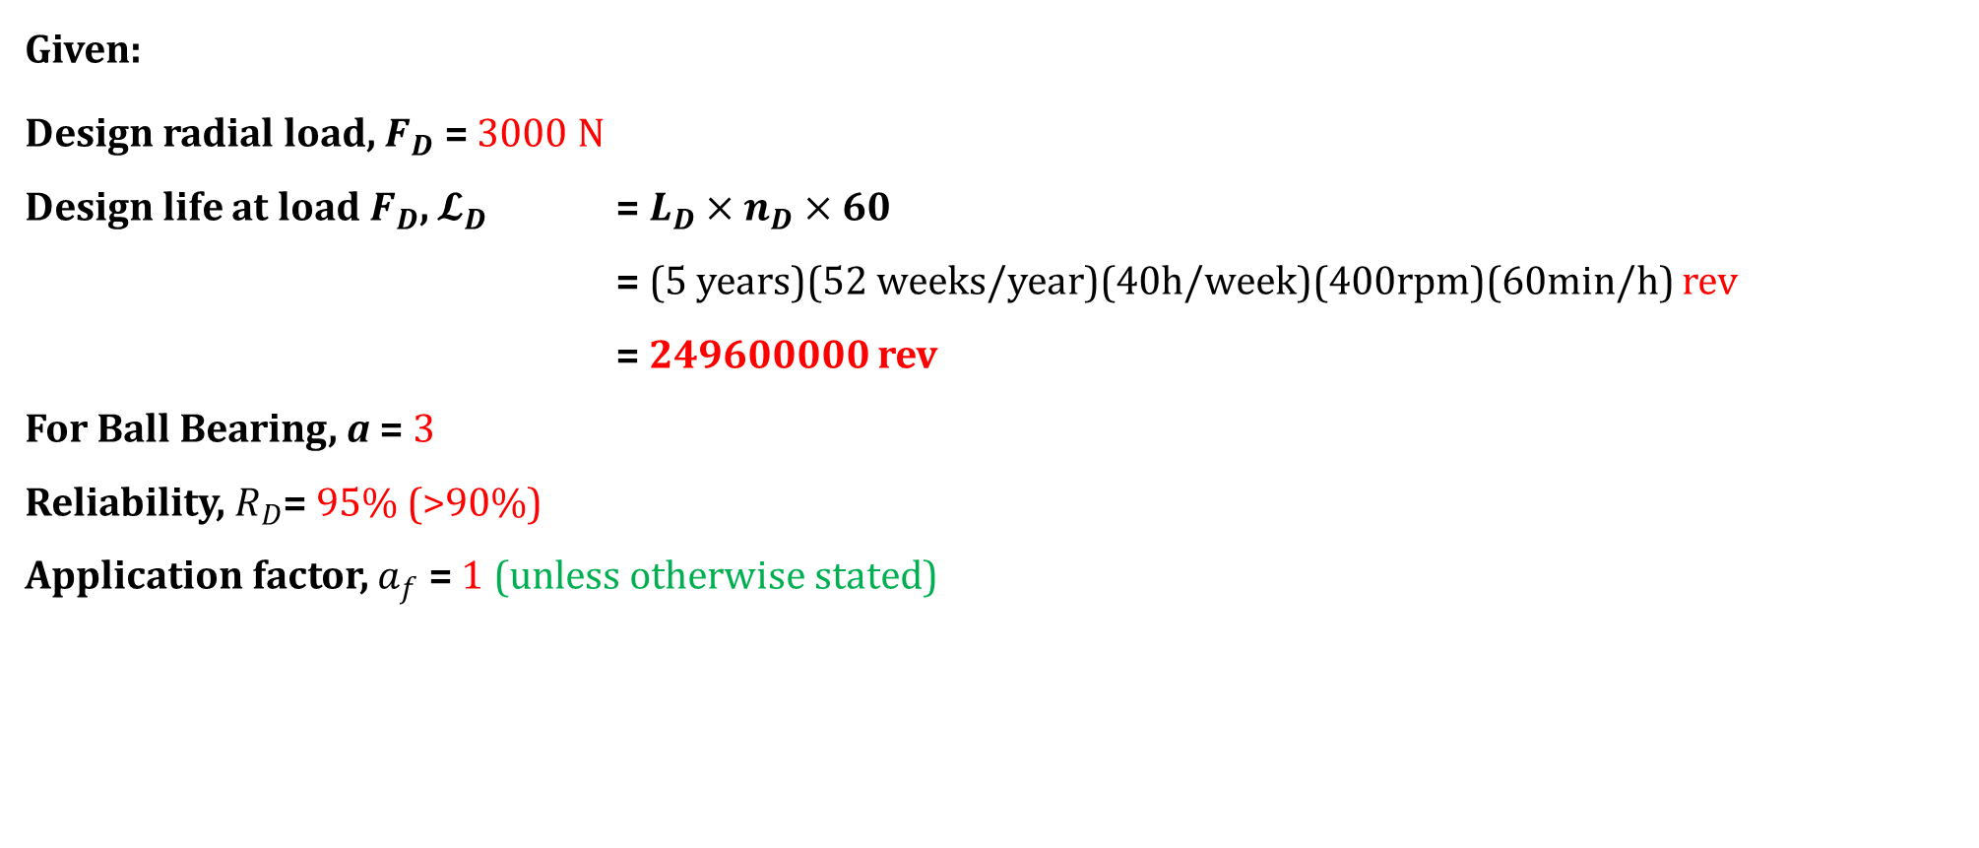
Load/Life Relationship problem 2 Solution
Given:
Design radial load, $F_{D}$ = 3000 N
Design life at load $F_{D}$, $𝓛_{D}$ = $L_{D}×n_{D}×60$
= (5 years)(52 weeks/year)(40h/week)(400rpm)(60min/h) rev
= 249600000 rev
For Ball Bearing, a = 3
Reliability, $R_{D}$= 95% (>90%)
Application factor, $a_{f}$ = 1 (unless otherwise stated)

Slide 8
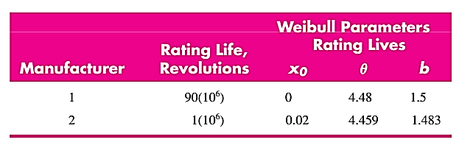
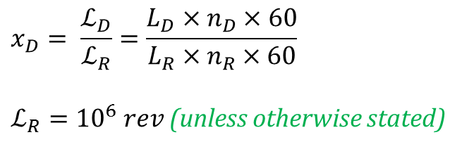
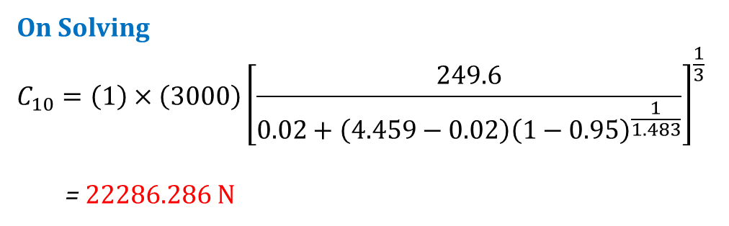


Load/Life Relationship problem 2 Solution (Contd…)
From Equation 2.1 (b), Design data handbook, page 12
$$C_{10}=a_{f}×F_{D}{\left[\frac{x_{D}}{x_{0}+\left(θ−x_{0}\right){\left(1−R_{D}\right)}^{\frac{1}{b}}}\right]}^{\frac{1}{a}}$$
Weibull parameters ($x_{0},θ,b)$
$$x_{0}=0.02$$
$$θ=4.459$$
$$b=1.483$$
$$x_{D}= \frac{ℒ_{D}}{ℒ_{R}}=\frac{L_{D}×n_{D}×60}{L_{R}×n_{R}×60}$$
$ℒ_{R}={10}^{6} rev$ (unless otherwise stated)
On Solving
$$C_{10}=\left(1\right)×\left(3000\right){\left[\frac{249.6}{0.02+\left(4.459−0.02\right){\left(1−0.95\right)}^{\frac{1}{1.483}}}\right]}^{\frac{1}{3}}$$
= 22286.286 N

Slide 9
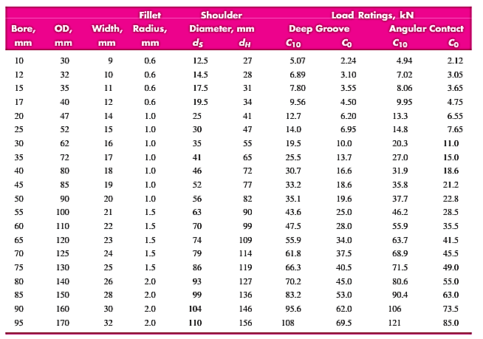
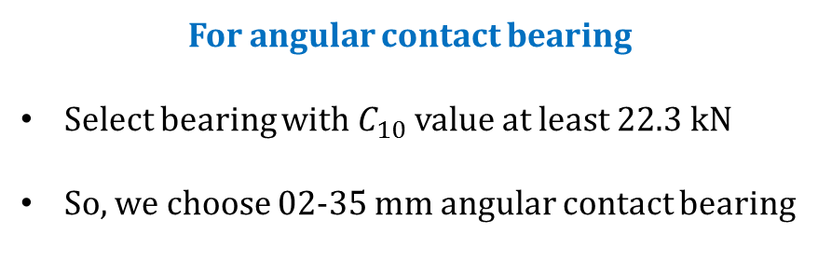
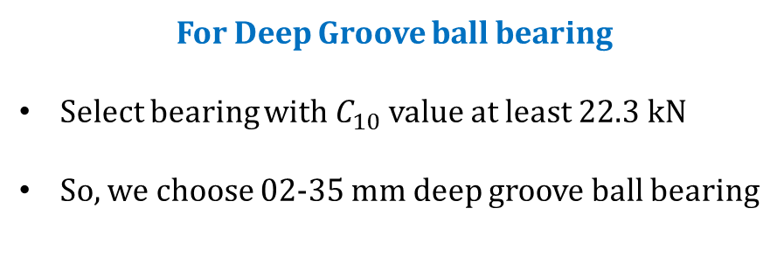
Load/Life Relationship problem 2 Solution (Contd…)
Selection of single-row deep groove ball bearing & angular contact bearing (Refer to Table 2-1, page 12)
Computed $C_{10}$ = 22286.286 N = 22.3 kN (approx.)
For Deep Groove ball bearing
Select bearing with $C_{10}$ value at least 22.3 kN
So, we choose 02-35 mm deep groove ball bearing
For angular contact bearing
Select bearing with $C_{10}$ value at least 22.3 kN
So, we choose 02-35 mm angular contact bearing

Slide 10
BEARING SELECTION: Radial and Thrust Loads combined
Select a single-row, deep-groove ball bearing to carry a radial load of 7 kN and a thrust load of 2 kN. The shaft is to rotate at 1150 rpm, and a design life of 20 kh is desired.

Slide 11
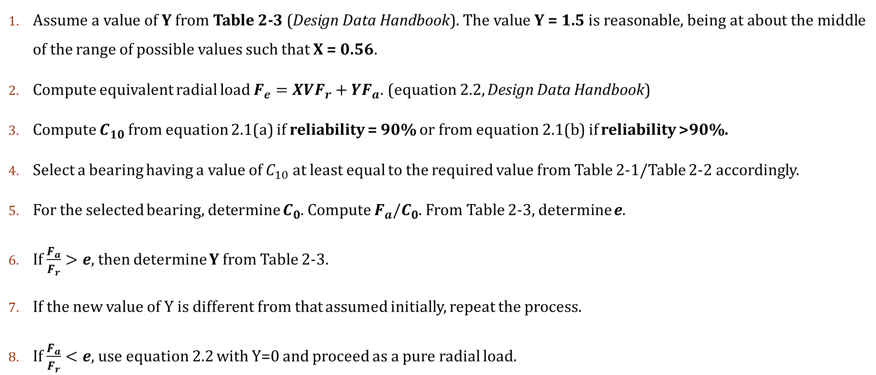
General procedure: Radial and Thrust Loads combined
Assume a value of Y from Table 2-3 (Design Data Handbook). The value Y = 1.5 is reasonable, being at about the middle of the range of possible values such that X = 0.56.
Compute equivalent radial load $F_{e}=XVF_{r}+{YF}_{a}$. (equation 2.2, Design Data Handbook)
Compute $C_{10}$ from equation 2.1(a) if reliability = 90% or from equation 2.1(b) if reliability >90%.
Select a bearing having a value of $C_{10}$ at least equal to the required value from Table 2-1/Table 2-2 accordingly.
For the selected bearing, determine $C_{0}$. Compute $F_{a}/C_{0}$. From Table 2-3, determine e.
If $\frac{F_{a}}{F_{r}}>e$, then determine Y from Table 2-3.
If the new value of Y is different from that assumed initially, repeat the process.
If $\frac{F_{a}}{F_{r}}<e$, use equation 2.2 with Y=0 and proceed as a pure radial load.

Slide 12
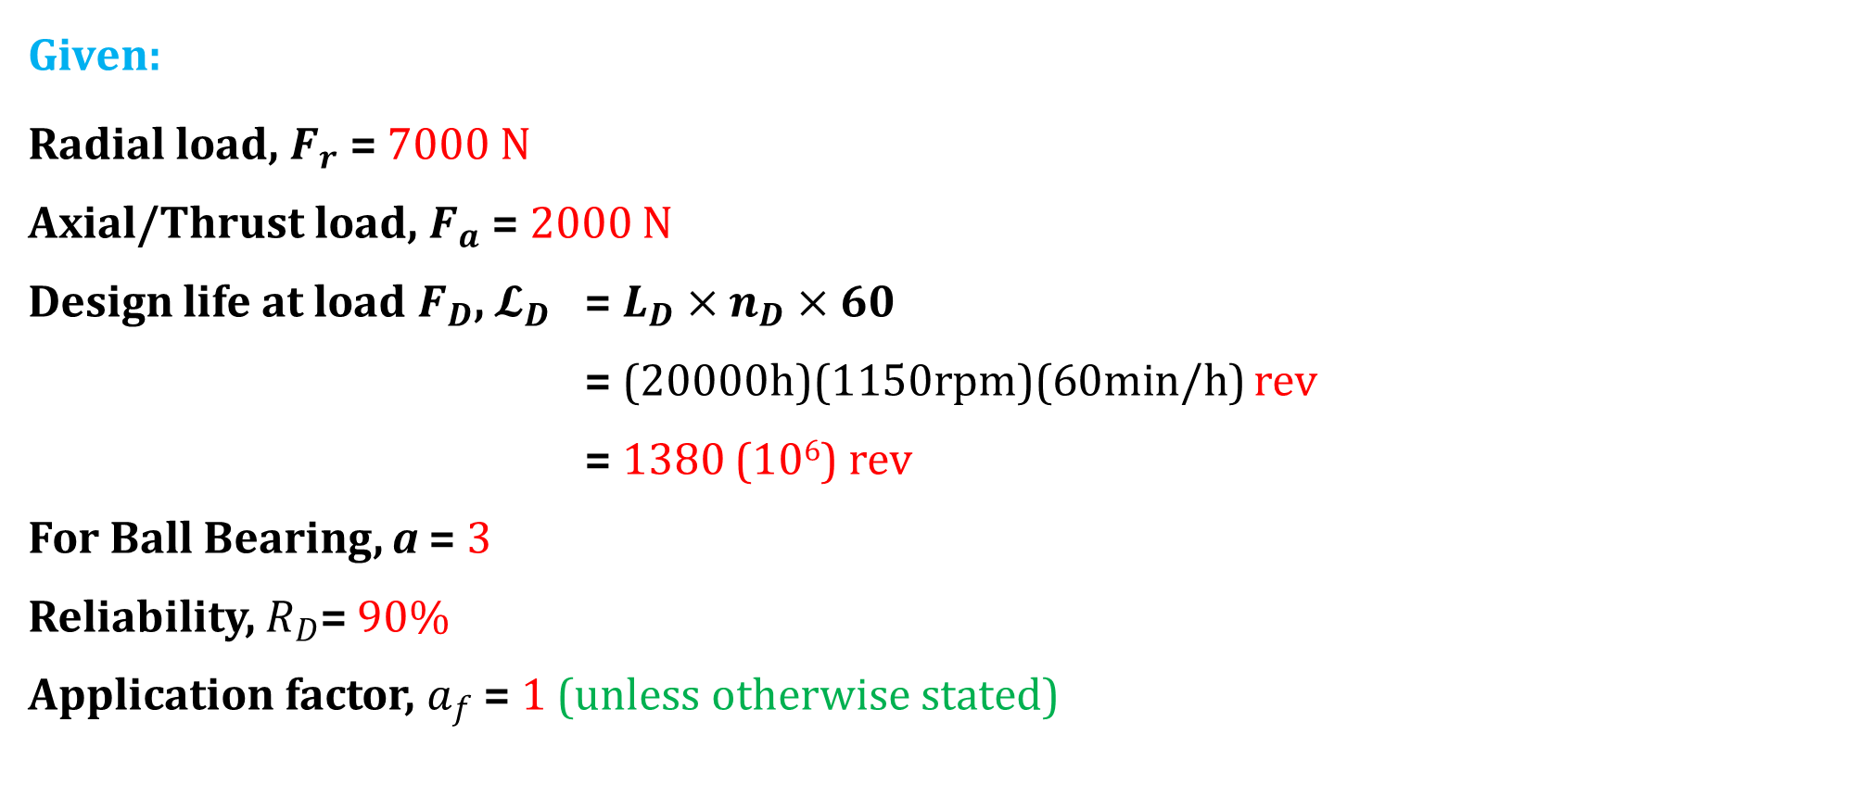
BEARING SELECTION: Radial and Thrust Loads combined Solution
Given:
Radial load, $F_{r}$ = 7000 N
Axial/Thrust load, $F_{a}$ = 2000 N
Design life at load $F_{D}$, $𝓛_{D}$ = $L_{D}×n_{D}×60$
= (20000h)(1150rpm)(60min/h) rev
= 1380 (10⁶) rev
For Ball Bearing, a = 3
Reliability, $R_{D}$= 90%
Application factor, $a_{f}$ = 1 (unless otherwise stated)

Slide 13
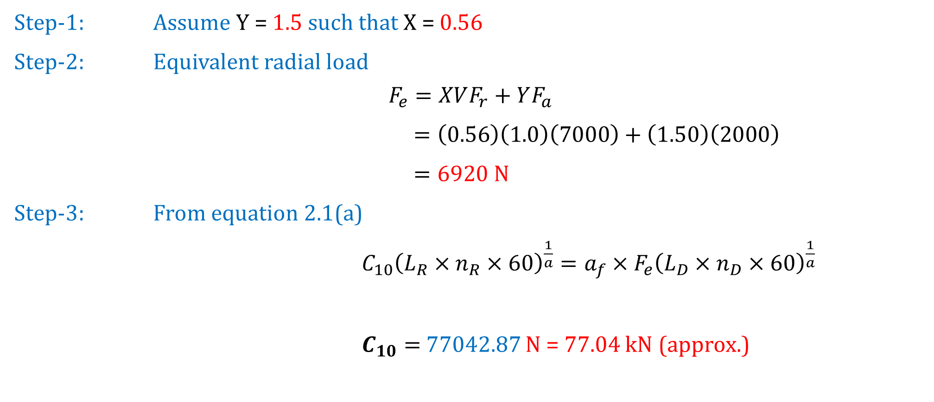
BEARING SELECTION: Radial and Thrust Loads combined Solution (Contd…)
Step-1: Assume Y = 1.5 such that X = 0.56
Step-2: Equivalent radial load
$$F_{e}=XVF_{r}+YF_{a}$$
$=\left(0.56\right)\left(1.0\right)\left(7000\right)+\left(1.50\right)\left(2000\right)$
$=6920 N$
Step-3: From equation 2.1(a)
$C_{10}{\left(L_{R}×n_{R}×60\right)}^{\frac{1}{a}}={a_{f}×F}_{e}{\left(L_{D}×n_{D}×60\right)}^{\frac{1}{a}}$
$C_{10}=$ 77042.87 N = 77.04 kN (approx.)

Slide 14

BEARING SELECTION: Radial and Thrust Loads combined Solution (Contd…)
Step-4: From Table 2-1
Possible Deep-Groove Bearing
02-85 mm deep groove ball bearing with
$C_{10}=83.2 kN$ (>77.04 kN)
Corresponding value of $C_{0}=53.0 kN$

Slide 15
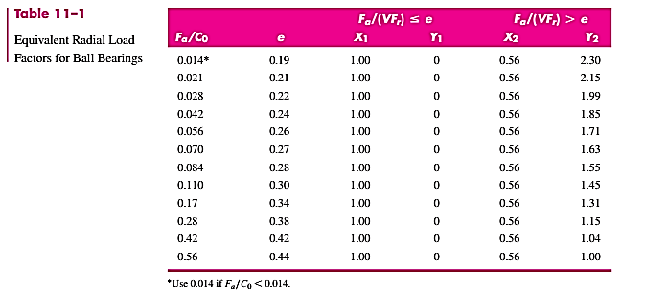

BEARING SELECTION: Radial and Thrust Loads combined Solution (Contd…)
Step-5: Computation of $F_{a}/C_{0}$
= 2000/53000
= 0.038
Step-6: From Table 2-3
(Determining value of e)
From Table,
e = 0.23 (approx.)

Slide 16
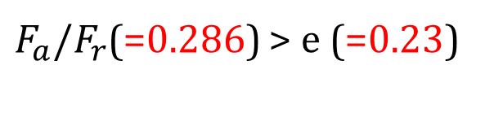

BEARING SELECTION: Radial and Thrust Loads combined Solution (Contd…)
Step-7: Computation of $F_{a}/F_{r}$
= 2000/7000
= 0.286
Computing value of Y from Table 2-3.
(Using Linear Interpolation)
$$Y=1.99+\frac{1.85−1.99}{0.042−0.028}(0.038−0.028)$$
$=$ 1.89
$F_{a}/F_{r}$(=0.286) > e (=0.23)

Slide 17
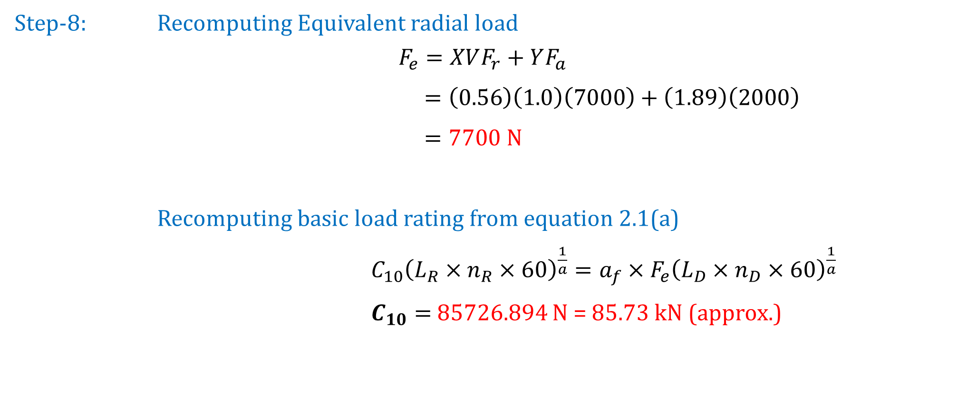
BEARING SELECTION: Radial and Thrust Loads combined Solution (Contd…)
Step-8: Recomputing Equivalent radial load
$$F_{e}=XVF_{r}+YF_{a}$$
$=\left(0.56\right)\left(1.0\right)\left(7000\right)+\left(1.89\right)\left(2000\right)$
$=7700$ N
Recomputing basic load rating from equation 2.1(a)
$C_{10}{\left(L_{R}×n_{R}×60\right)}^{\frac{1}{a}}={a_{f}×F}_{e}{\left(L_{D}×n_{D}×60\right)}^{\frac{1}{a}}$
$C_{10}=$ 85726.894 N = 85.73 kN (approx.)
Since, the 02-85 mm deep groove ball bearing has C₁₀ value of 83.2 kN, it is not satisfactory at this load.

Slide 18
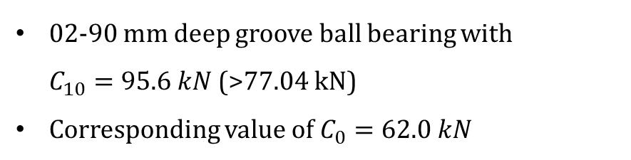
BEARING SELECTION: Radial and Thrust Loads combined Solution (Contd…)
Let’s continue with another bearing.
02-90 mm deep groove ball bearing with
$C_{10}=95.6 kN$ (>77.04 kN)
Corresponding value of $C_{0}=62.0 kN$
Repeat the processes again from Step 5.

Slide 19

BEARING SELECTION: Radial and Thrust Loads combined Solution (Contd…)
Step-5: Computation of $F_{a}/C_{0}$
= 2000/62000
= 0.032
Step-6: From Table 2-3
(Determining value of e)
From Table,
e = 0.225 (approx.)

Slide 20
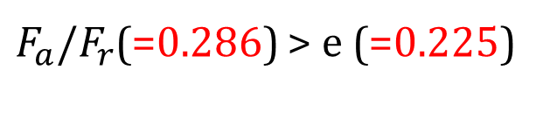

BEARING SELECTION: Radial and Thrust Loads combined Solution (Contd…)
Step-7: Computation of $F_{a}/F_{r}$
= 2000/7000
= 0.286
Computing value of Y from Table 2-3.
(Using Linear Interpolation)
$$Y=1.99+\frac{1.85−1.99}{0.042−0.028}(0.032−0.028)$$
$=$ 1.95
$F_{a}/F_{r}$(=0.286) > e (=0.225)

Slide 21
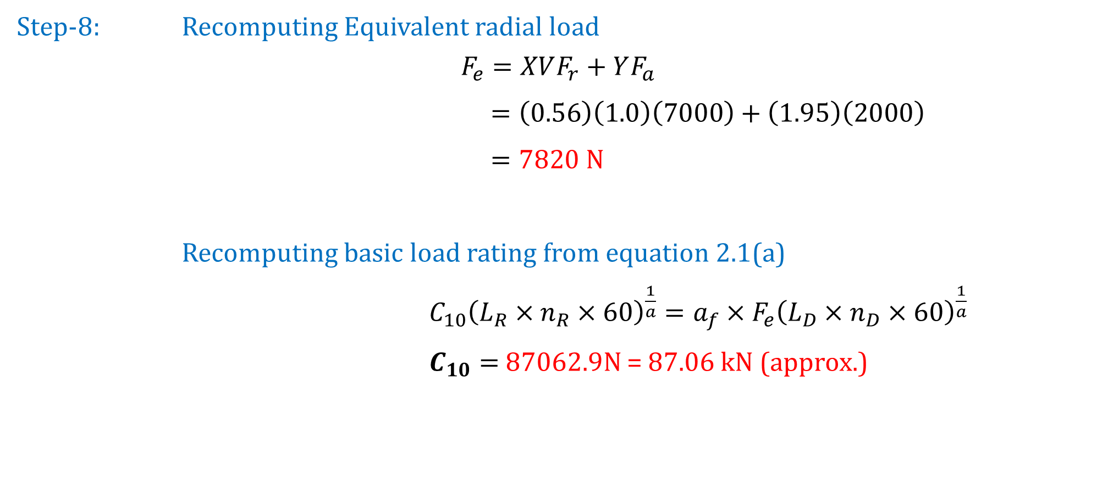
BEARING SELECTION: Radial and Thrust Loads combined Solution (Contd…)
Step-8: Recomputing Equivalent radial load
$$F_{e}=XVF_{r}+YF_{a}$$
$=\left(0.56\right)\left(1.0\right)\left(7000\right)+\left(1.95\right)\left(2000\right)$
$=7820$ N
Recomputing basic load rating from equation 2.1(a)
$C_{10}{\left(L_{R}×n_{R}×60\right)}^{\frac{1}{a}}={a_{f}×F}_{e}{\left(L_{D}×n_{D}×60\right)}^{\frac{1}{a}}$
$C_{10}=$ 87062.9N = 87.06 kN (approx.)
Since, the 02-90 mm deep groove ball bearing has C₁₀ value of 95.6 kN, it is satisfactory.

Slide 22
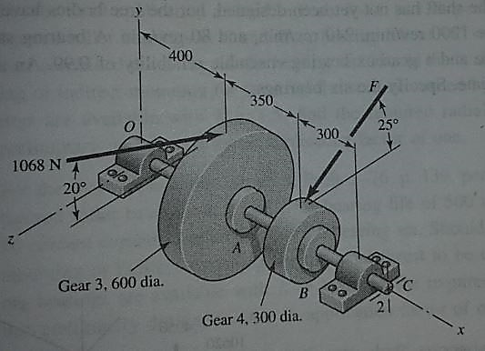
SELECTION OF angular-contact ball bearing
A gear-reduction unit uses the countershaft depicted in the figure. Find the two bearing reactions. The bearings are to be angular-contact ball bearings, having a desired life of 40 kh when used at 200 rev/min. Use 1.2 for the application factor and a reliability goal for the bearing pair of 0.95. Select the suitable bearings.

Slide 23
SELECTION OF tapered roller bearing

Slide 24
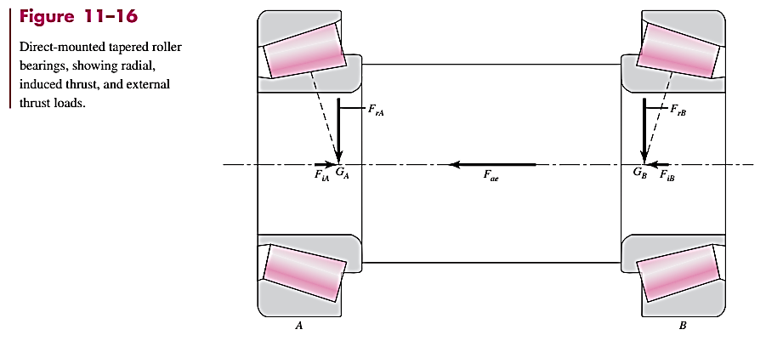

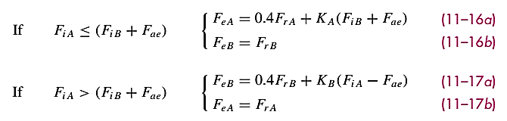
SELECTION OF Tapered roller bearing
Some terms to be familiar with before selection of Tapered Roller Bearing
What about value of K ??
Assume, K = 1.5 (initially), as we have assumed value of Y = 1.5 for selection of angular/roller bearing.
Later its value has to be refined.
In any case, if the equivalent radial load is less than the original radial load, then the original radial load should be used instead of that equivalent radial load.

Slide 25
SELECTION OF Tapered Roller bearing
A countershaft is supported by two tapered roller bearings using an indirect mounting. The radial bearing loads are 2240 N for the left-hand bearing and 4380 N for the right-hand bearing. An axial load of 800 N is carried by the left bearing. The shaft rotates at 400 rpm and is to have a desired life of 40 kh. Use an application factor of 1.4 and a combined reliability goal of 0.90. Using an initial K = 1.5, find the required radial rating for each bearing. Select the bearings from Table 2-4.

Slide 26
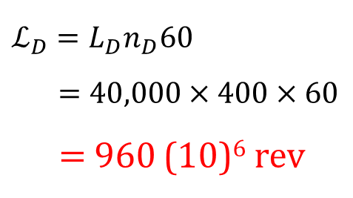

SELECTION OF Tapered Roller bearing (Solution)
F_{rA} =2240 N
F_{rB} = 4380 N
F_{ae} = 800 N
Design speed, n_{D} = 400 rpm
Design Life, L_{D} = 40,000 h
Application factor, a_{f} = 1.4
Combined Reliability, R = 0.90
Reliability of each bearing
R_{A} = R_{B}=$√R$ =$√0.9$=0.949
$$ℒ_{D}=L_{D}n_{D}60$$
$=40,000×400×60$
$=$ 960 (10)⁶ rev

Slide 27
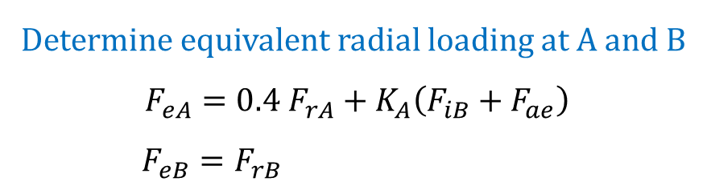


SELECTION OF Tapered Roller bearing (Solution) (CONTD…)
Trial-I
Assume K = 1.5 (Later this value has to be refined)
$F_{iA}=\frac{0.47F_{rA}}{K_{A}}=0.47×\frac{2240}{1.5}=701.867 N$
$$F_{iB}=\frac{0.47F_{rB}}{K_{B}}=0.47×\frac{4380}{1.5}=1372.4 N$$
Checking criteria
$$F_{iA}\left(=701.867\right) [F_{iB}\left(=1372.4\right)+F_{ae}\left(=800\right)]$$
Determine equivalent radial loading at A and B
$$F_{eA}=0.4 F_{rA}+K_{A}\left(F_{iB}+F_{ae}\right)$$
$F_{eB}=F_{rB}$
On solving
$$F_{eA}=4154.6 N$$
$$F_{eB}=4380.0 N$$
<

Slide 28





SELECTION OF Tapered Roller bearing (Solution) (CONTD…)
$$x_{D}=\frac{ℒ_{D}}{ℒ_{R}}=\frac{960}{90}=10.667$$
Determining Catalog rating value $C_{10}$ for bearing A and B
On solving
$$C_{10A}=13682.722 N$$
$$C_{10B}=14425.052 N$$
Weibull parameters $x_{O},θ and b$
For rated life of $90{\left(10\right)}^{6} rev$
$$x_{0}=0;θ=4.48 \& b=1.5$$
For roller bearing (Tapered roller)
a = 10/3

Slide 29
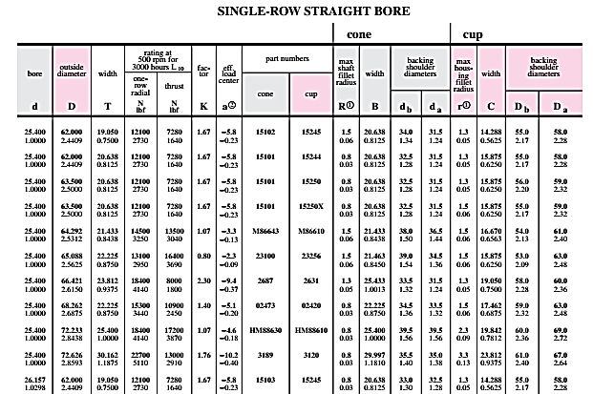

SELECTION OF Tapered Roller bearing (Solution) (CONTD…)
Bearing Selection based on $C_{10A} \& C_{10B}$ (Table 2-4)
For A
Select M86643 cone, M86610 cup and rated value of 14500 N with K = 1.07
For B
Select M86643 cone, M86610 cup as well and rated value of 14500 N with K = 1.07

Slide 30


SELECTION OF Tapered Roller bearing (Solution) (CONTD…)
Trial-II
Computing $F_{eA} \& F_{eB}$ with $K_{A}$ = $K_{B}$ = 1.07
$F_{iA}=\frac{0.47F_{rA}}{K_{A}}=0.47×\frac{2240}{1.07}=983.925 N$
$$F_{iB}=\frac{0.47F_{rB}}{K_{B}}=0.47×\frac{4380}{1.07}=1923.925 N$$
Checking criteria
$$F_{iA}\left(=983.925\right) [F_{iB}\left(=1923.925\right)+F_{ae}\left(=800\right)]$$
Determine equivalent radial loading at A and B
$$F_{eA}=0.4 F_{rA}+K_{A}\left(F_{iB}+F_{ae}\right)$$
$F_{eB}=F_{rB}$
On solving
$$F_{eA}=3810.6 N$$
$$F_{eB}=4380.0 N$$
<

Slide 31


SELECTION OF Tapered Roller bearing (Solution) (CONTD…)
Recomputing Catalog rating value $C_{10}$ for bearing A and B
For roller bearing (Tapered roller)
a = 10/3
On solving
$$C_{10A}=12549.795 N$$
$$C_{10B}=14425.052 N$$
Weibull parameters $x_{O},θ and b$
For rated life of $90{\left(10\right)}^{6} rev$
$$x_{0}=0;θ=4.48 \& b=1.5$$
The selected bearings A and B (i.e., M86643 cone, M86610 cup) works satisfactorily for this working conditions as it has $C_{10}$ of 14500 N.

Slide 32
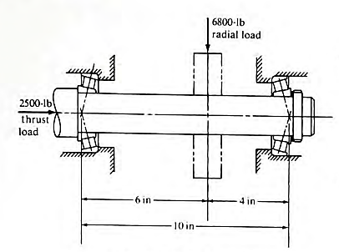
SELECTION OF Tapered roller bearing
The shaft shown in figure below carries a transverse load of 32500 N and a thrust load of 11120 N. The shaft rotates at 350 rpm and is to be used for 4 kh. Specify suitable tapered roller bearings for the shaft. Reliability of the bearing set is 0.99 and an application factor of unity.
32500 N
Which bearing would you recommend if the minimum acceptable diameter for the shaft, where the bearings are mounted is 55 mm?
11120N
Timken Tapered Roller Bearing Catalog
150
100
250

